Slide 1
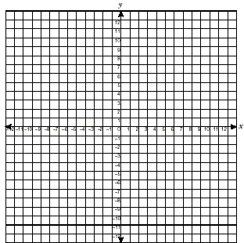
A FUNCTION is a relation in which each first value is paired with one and ONLY ONE second value.
Relation (a set of ordered pairs)
Input-Output Tables
x | 2 | 1 | 0 | -1 | -2
y | 1 | 2 | 3 | 4 | 5
x y
( 2 , 1)
( 3 , 2)
( 4 , 3)
( 3 , 4)
Decide whether the relation is a function. Yes or No
Why or why not?
____________________
____________________
____________________
x | y
2 | 1
1 | 2
0 | 3
-1 | 4
-2 | 5
Decide whether the relation is a function. Yes or No
Why or why not?
_______________________
_______________________
_______________________
Mapping
Vertical Line Test for Functions: a VERTICAL line crosses only one point on the graph
X
Y
Decide whether the relation is a function. Yes or No
Why or why not?
______________
______________
______________
______________
1
2
2
4
-1
-2
-2
4
Decide whether the relation is a function. Yes or No
Why or why not?
_______________
_______________
_______________
_______________
MCC9-12.F.IF.1 Understand that a function from one set (called the domain) to another set (called the range) assigns to each element of
the domain exactly one element of the range. If f is a function and x is an element of its domain, then f(x) denotes the output of f corresponding to the input x. The graph of is the graph of the equation y = f(x).

